Slide 1
XSAM course
Stock assessment - basics
Sondre Aanes
IMR, Bergen
15 - 17/1-2017

Slide 2
Refreshing the basics
Stock assessment – some fundamentals for age structured assessment methods

Slide 3
Fish stock assessment
Understanding population dynamics and effects of harvesting
Being able to estimate population parameters and predict the effect of management actions
The feedback of a management action (quota, regulations including gear/space/time, etc) on the population; on short and long term
Several approaches depending on what data is available
Surplus production
Length structured
Age structured (focus here)
Age and length structured

Slide 4
Age structured assessment methods
Cohort models – tracing cohorts through time
Uses age composition as source of information for understanding population dynamics
The most frequently applied method for commercially important fish stocks.
Data demanding
Requires monitoring programs

Slide 5
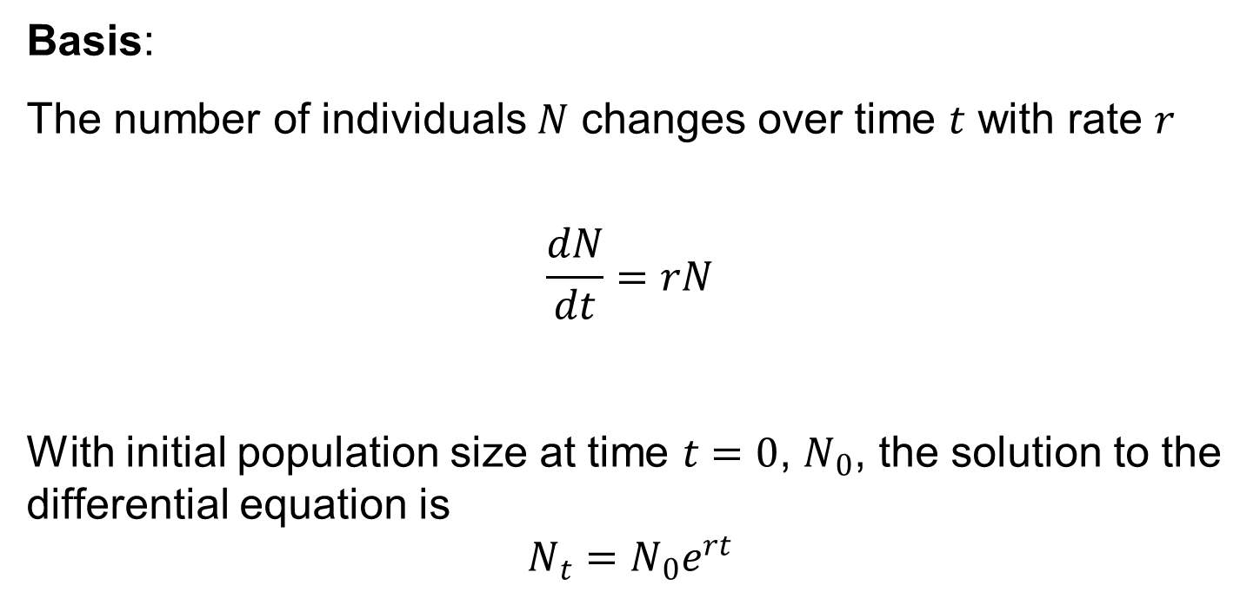
Quantitative year class dynamics
Basis:
The number of individuals $N$ changes over time $t$ with rate $r$
$$\frac{dN}{dt}=rN$$
With initial population size at time $t=0$, $N_{0}$, the solution to the differential equation is
$$N_{t}=N_{0}e^{rt}$$

Slide 6

Quantitative year class dynamics
If we are tracing cohorts $r$ is the instantaneous death rate $−Z$ and for time increments of 1 year
$$N_{a+1,t+1}=N_{a,t}e^{−Z_{a,t}}$$
survival

Slide 7

Quantitative year class dynamics
Decomposing mortality
$$Z=F+M$$
$F$ is fishing mortality
$M$ is natural mortality

Slide 8
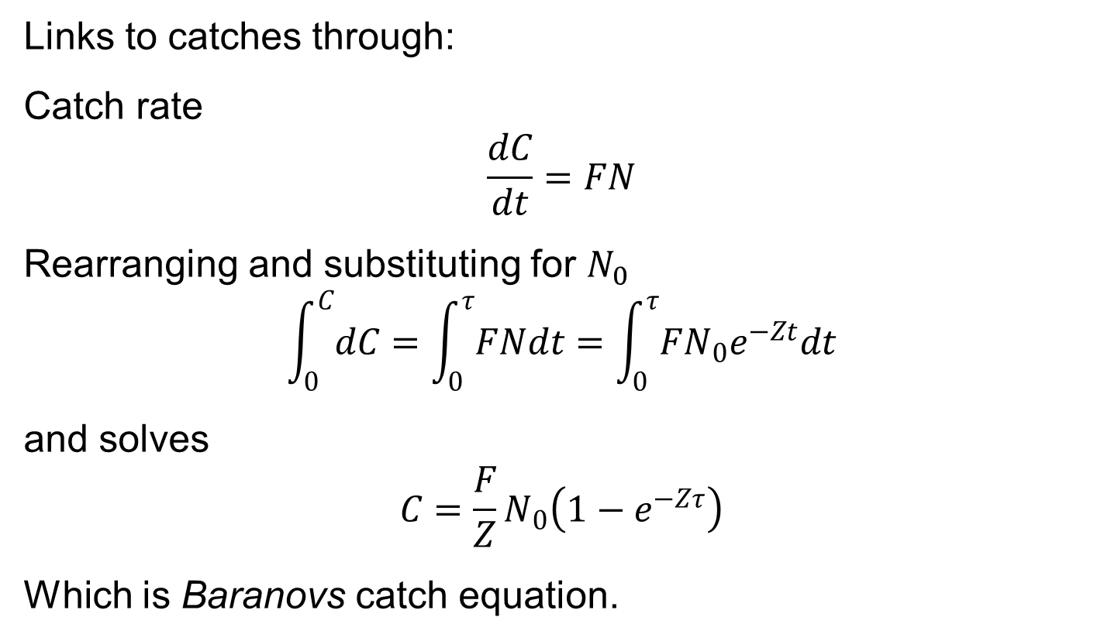
Quantitative year class dynamics
Links to catches through:
Catch rate
$$\frac{dC}{dt}=FN$$
Rearranging and substituting for $N_{0}$
$$\int_{0}^{C}{dC}=\int_{0}^{τ}{FNdt}=\int_{0}^{τ}{FN_{0}e^{−Zt}dt}$$
and solves
$$C=\frac{F}{Z}N_{0}\left(1−e^{−Zτ}\right)$$
Which is Baranovs catch equation.

Slide 9
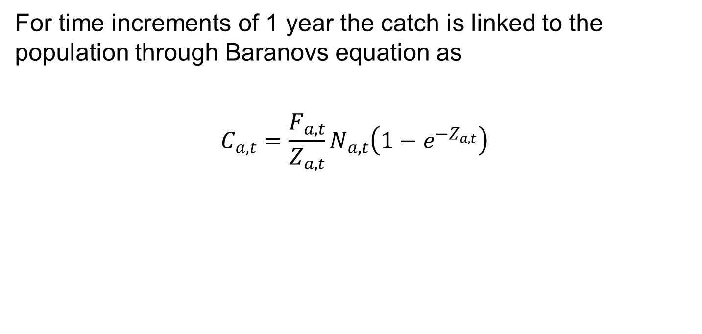
Quantitative year class dynamics
For time increments of 1 year the catch is linked to the population through Baranovs equation as
$$C_{a,t}=\frac{F_{a,t}}{Z_{a,t}}N_{a,t}\left(1−e^{−Z_{a,t}}\right)$$

Slide 10
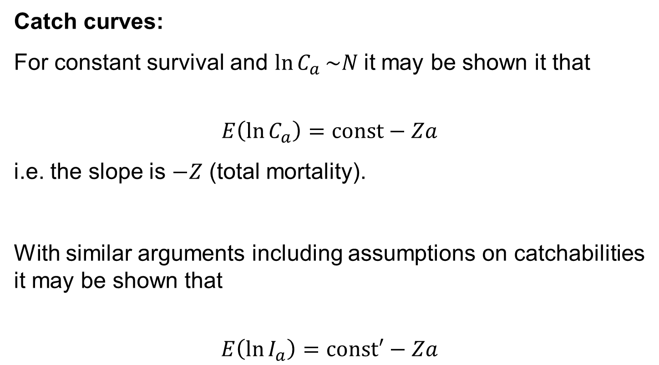
Useful link to observations
Catch curves:
For constant survival and $\ln{C_{a}}\sim N$it may be shown it that
$$E\left(\ln{C_{a}}\right)=const−Za$$
i.e. the slope is $−Z$ (total mortality).
With similar arguments including assumptions on catchabilities it may be shown that
$$E\left(\ln{I_{a}}\right)=const′−Za$$

Slide 11
Comments
Note 1: Most common types of data available
Catch at age
Abundance indices at age (here: from scientific surveys)
Less typical:
Mark-recapture from tagging
Stomach contents

Slide 12
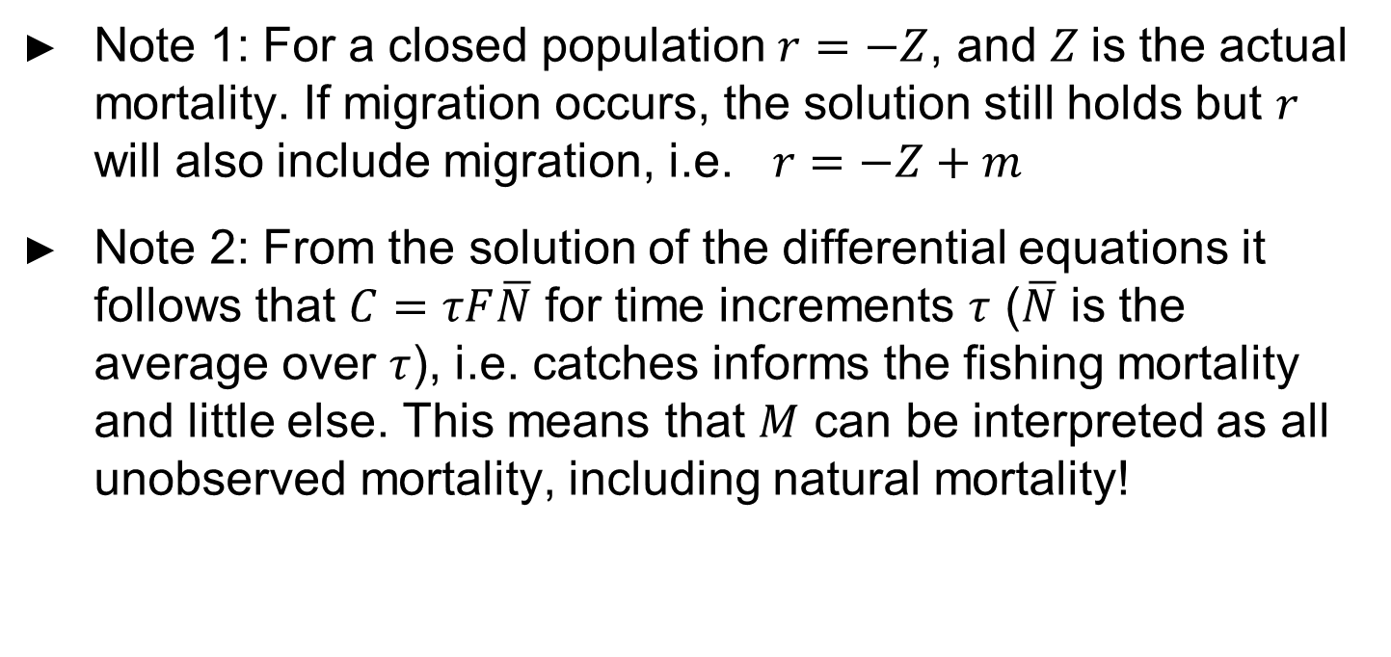
Comments
Note 1: For a closed population $r=−Z$, and $Z$is the actual mortality. If migration occurs, the solution still holds but $r$ will also include migration, i.e. $r=−Z+m$
Note 2: From the solution of the differential equations it follows that $C=τF\overline{N}$ for time increments $τ$ ($\overline{N}$ is the average over $τ$), i.e. catches informs the fishing mortality and little else. This means that $M$ can be interpreted as all unobserved mortality, including natural mortality!

Slide 13
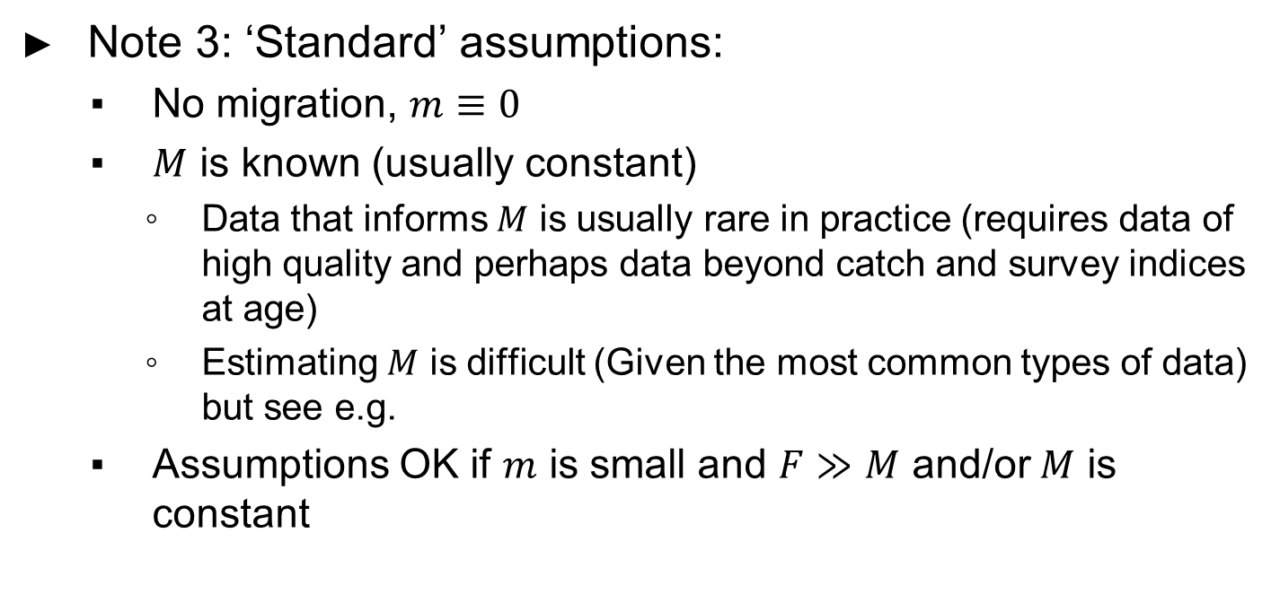
Comments
Note 3: ‘Standard’ assumptions:
No migration, $m≡0$
$M$ is known (usually constant)
Data that informs $M$ is usually rare in practice (requires data of high quality and perhaps data beyond catch and survey indices at age)
Estimating $M$ is difficult (Given the most common types of data) but see e.g.
Assumptions OK if $m$ is small and $F≫M$ and/or $M$ is constant

Slide 14
Comments
This summarizes some of the fundamentals for most age structured fish dynamical models
Cohort equations and Baranovs equation are fundamental in methods/models such as VPA, XSA, ADAPT, Stock Synthesis, SAM, XSAM ++

Slide 15
More on this topic
See for example Quinn and Deriso (1999) for an excellent introduction to quantitative fish dynamics.

Slide 16
Data used in stock assessment
Main data
Catch at age by time
Survey indices at age by time
To obtain estimates of biomass and spawning stocks
Weight at age and time in stock and catch
Proportion mature at age by time
Other data
Tagging data
Stomach contents

Slide 17
Exercise
Herring example
Do empirical data analysis of traditional data
See: EDA_herring.R in ‘…XSAMcourse/Examples/’
Note: proper empirical data analysis should include more than catchcurves. Should at least also include internal and external consistency measures!

